Slide 1
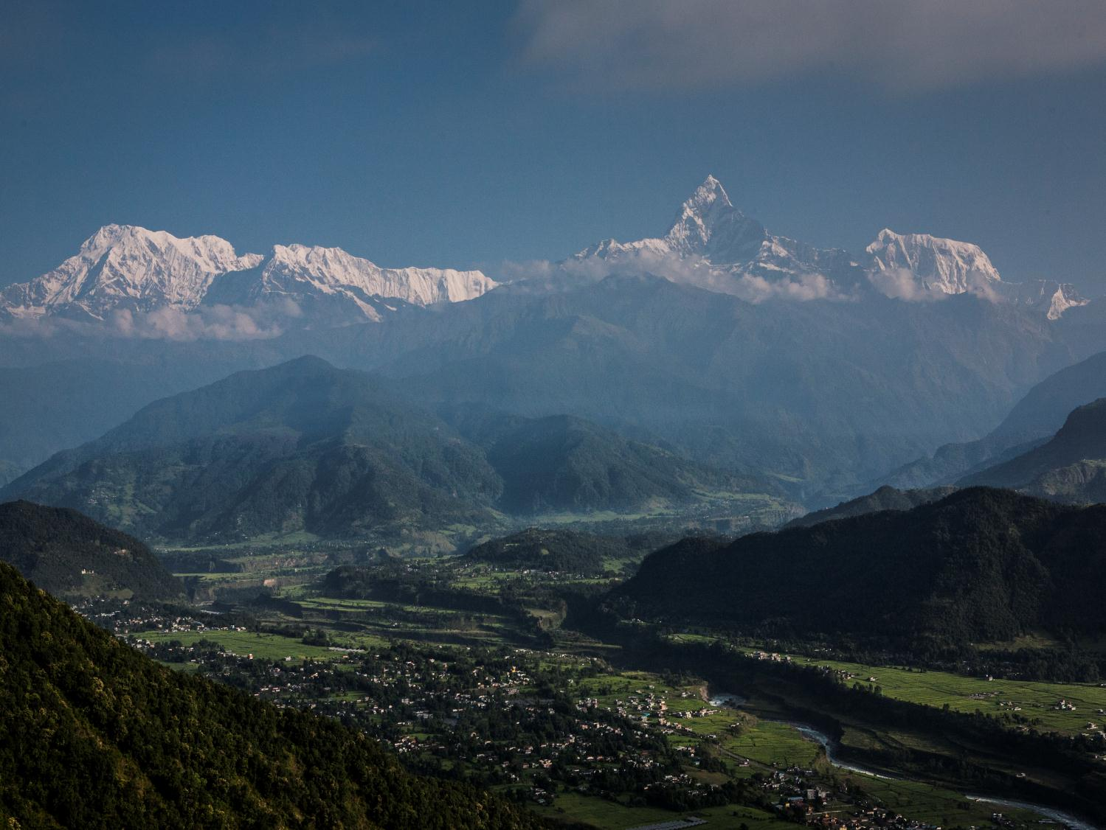
Nepal Risk Reduction Consortium and HFA Platform

Slide 2
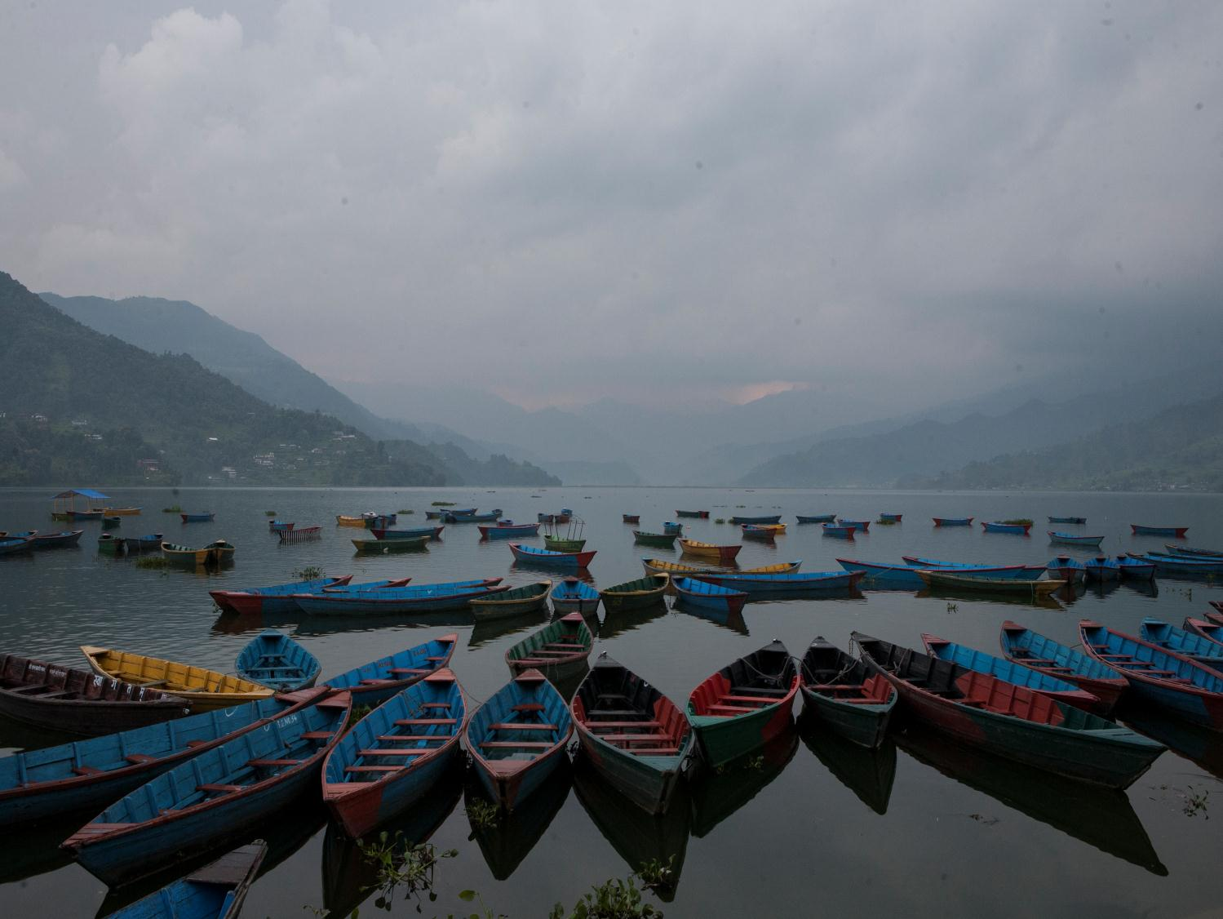
Nepal Risk Reduction Consortium
Bringing the Government of Nepal, financial institutions, humanitarian and development partners together to work collectively towards risk reduction
Based on the National Strategy for Disaster Risk Management and the HFA
Objective of NRRC is to make DRR a priority for Government and partners in Nepal

Slide 3

Flagship 1: School and Hospital Safety
Will strengthen over 900 school buildings and 10 major health care facilities in Kathmandu Valley for earthquake resistance and service continuity
HFA Priority:
  II: Know the risk and take action
  III: Build understanding and awareness

Slide 4
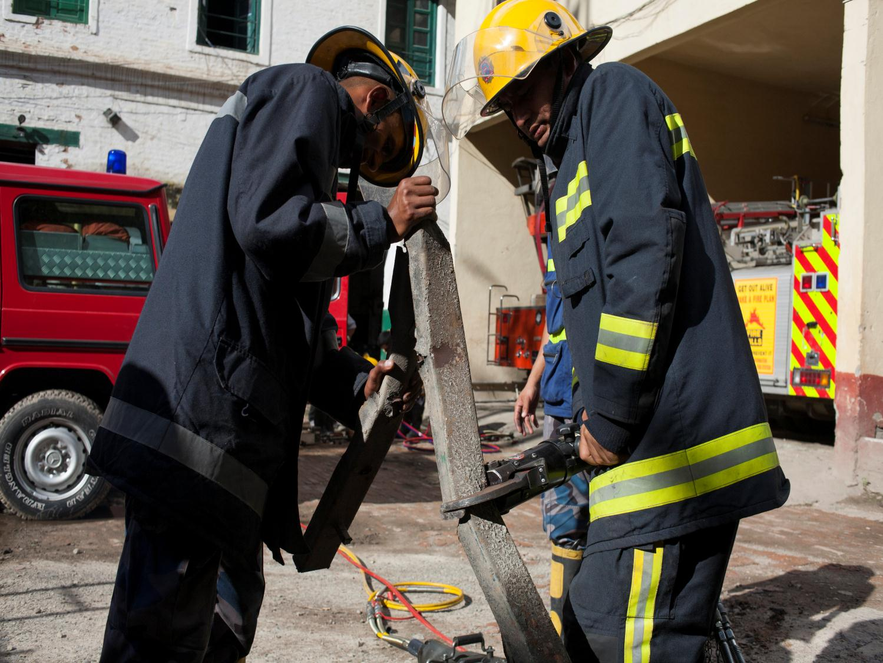
Flagship 2: Emergency Preparedness and Response
Will prepare and train first responders, develop disaster response and information planning, warehousing and stockpiling, prepare open spaces and facilitate international assistance for emergency response
HFA Priority:
  V: Be prepared and ready to act

Slide 5
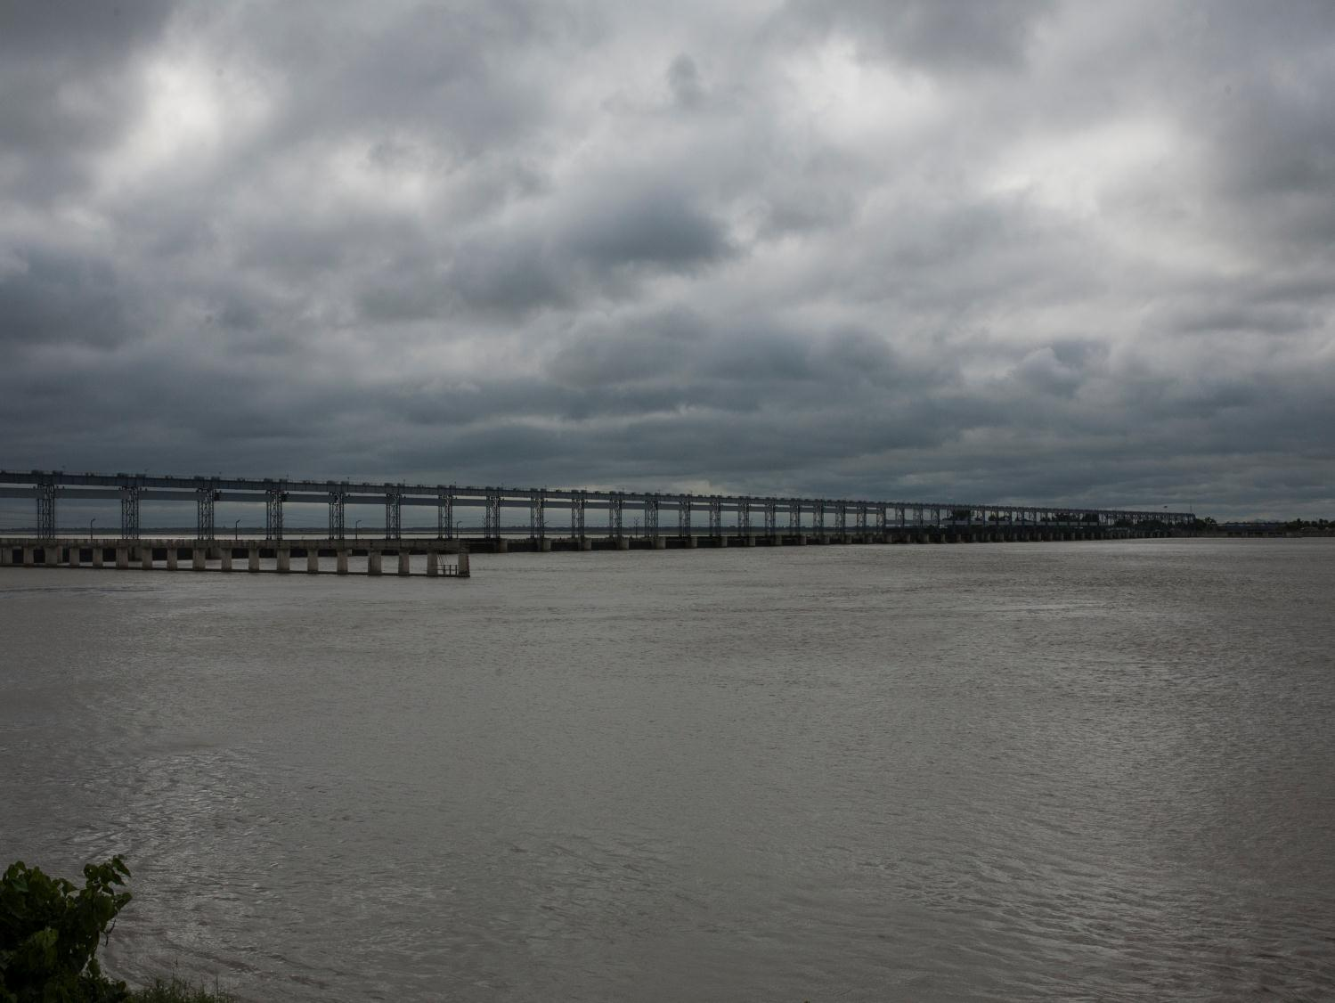
Flagship 3: Flood Management in the Kosi River Basin
Will reduce flood risk in the Kosi River Basin through detailed assessments, forecasting and mitigation activities
HFA Priority:
  II: Know the Risk and Take Action
  III: Build Understanding and Awareness

Slide 6
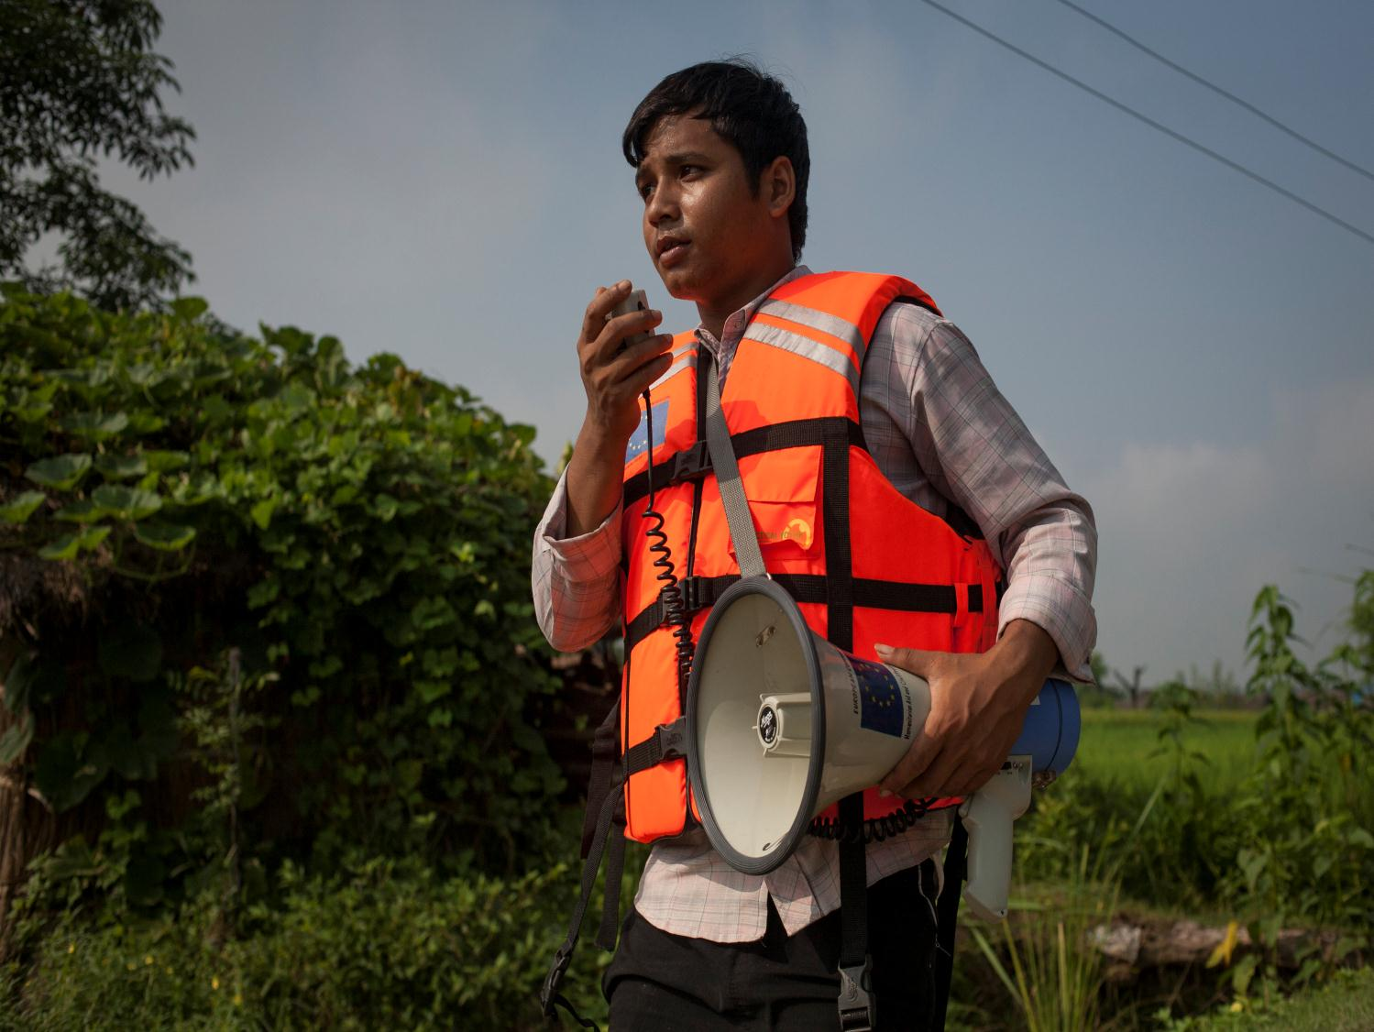
Flagship 4: CBDRR
Will complete CBDRR activities in 1,000 VDCs/municipalities over 5 years
HFA Priority:
  I: Make DRR a priority (at community level)
  II: Know the risk and take action
  III: Build understanding and awareness

Slide 7

Flagship 5: Policy/Institutional Support for DRM
Will integrate DRM in plans, policies, and programmes at national, district and local levels and strengthen the enforcement and compliance of building codes
HFA Priority
  I: Make DRR a priority
  IV: Reduce underlying risk factors

Slide 8
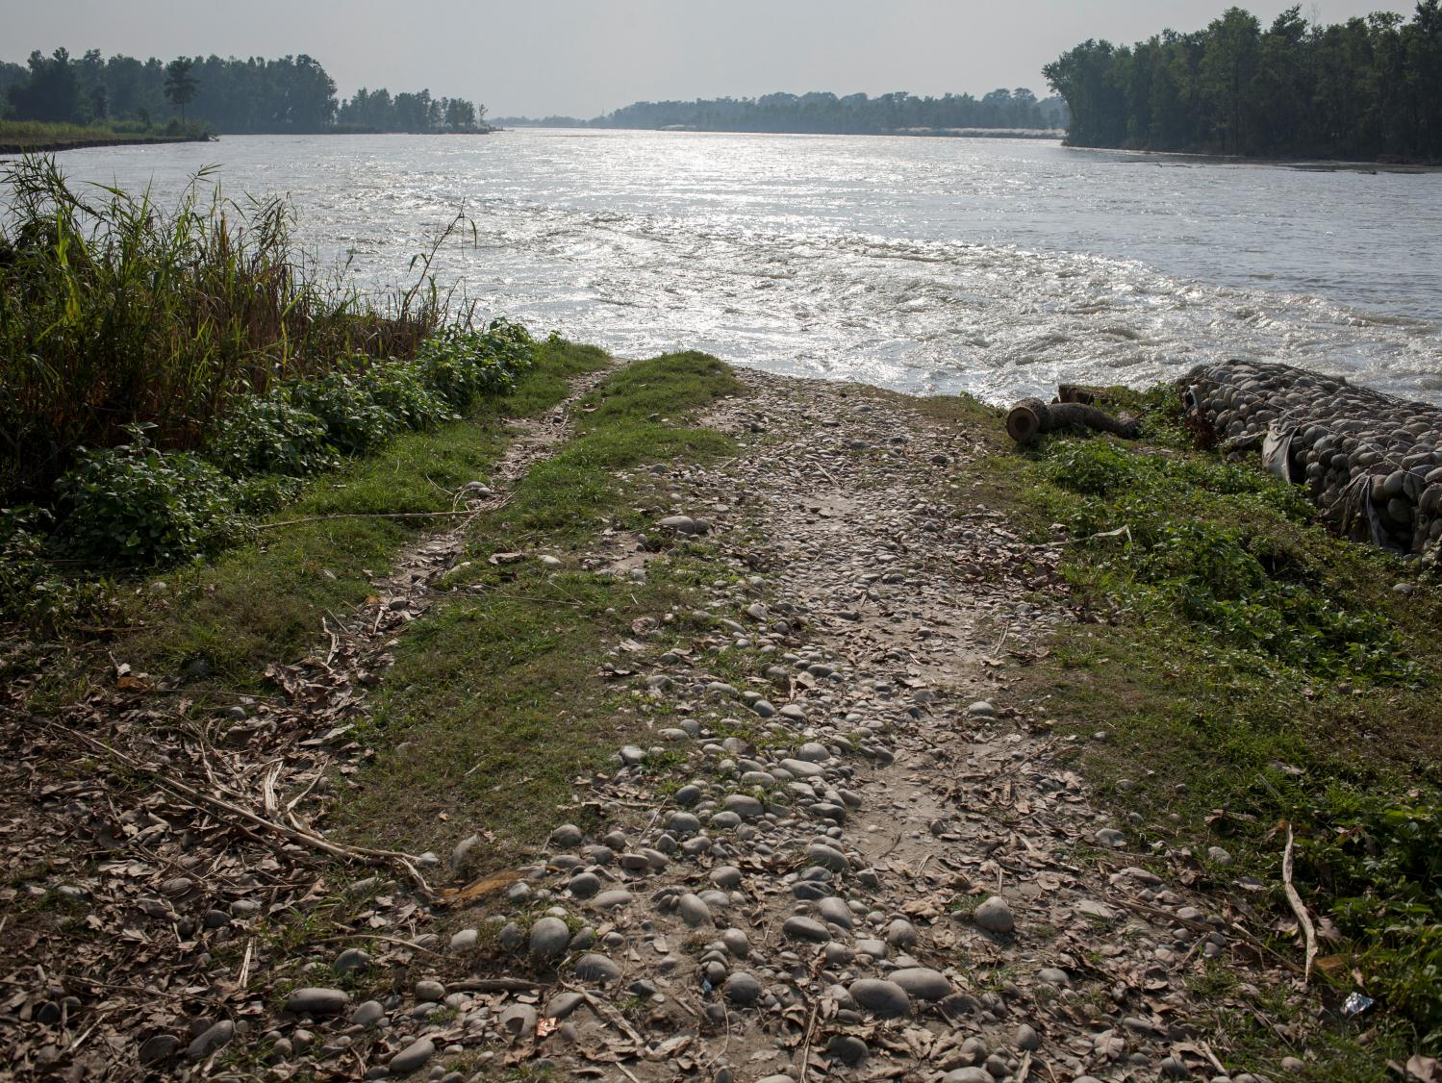
Issues to Consider for Post HFA
How do we maintain and build on the momentum achieved in the last 3-5 years?
  Awareness
  Policy engagement
  Preparedness
  Reducing new risk
  Minimising current risk
  Global recognition (political champions, Global Platform etc)

Slide 9
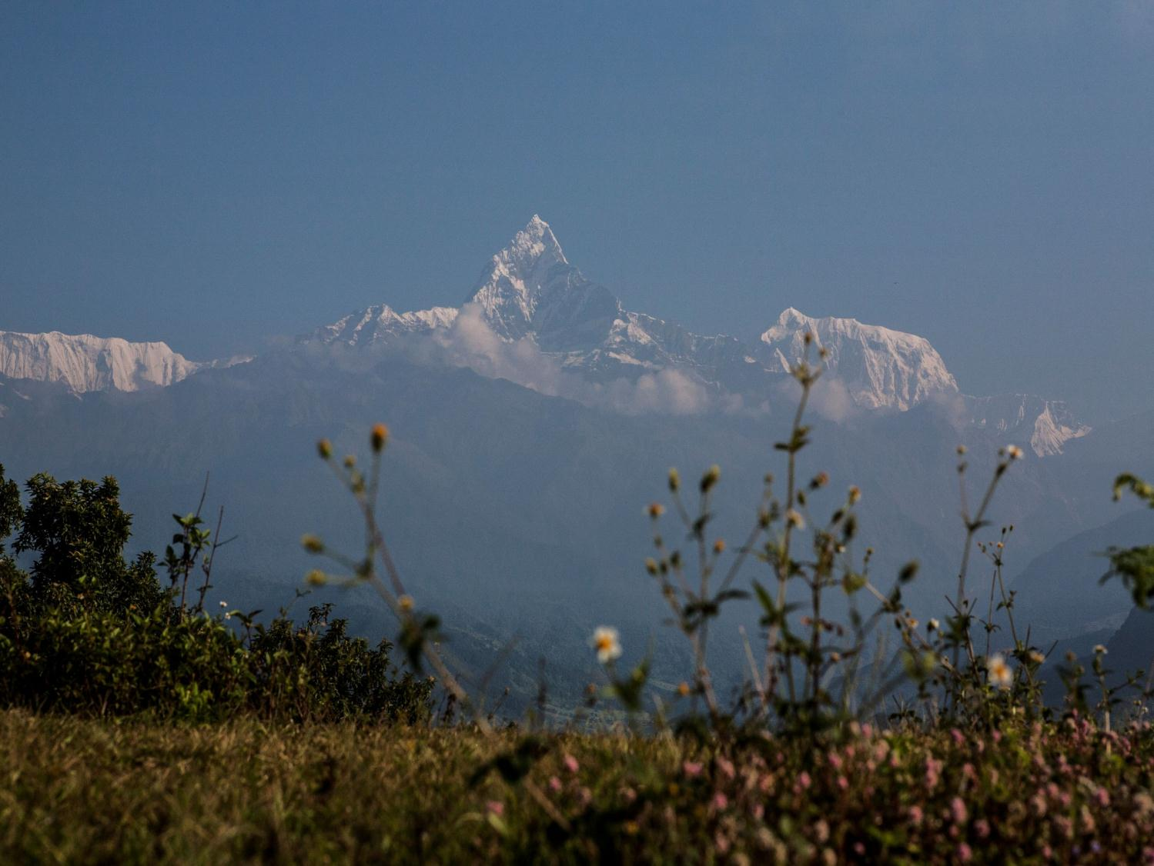
Post HFA Thinking from Nepal
Promote large scale media involvement
National level multi-hazard risk assessment
Mainstream C/DRM in planning, implementation and M&E
Strengthen post disaster response and recovery
Promote wider coverage of CBDRM/LDRM

Slide 10
Issues to Consider for Post HFA
  Currently the NRRC work plan extends to 2015 – the same timeline as the HFA. What is the timeline for the Platform? Is this the future of the NRRC? What relationship between the NRRC/NDMA in the future?
  Looking forward together – best mechanisms for info sharing/avoiding duplication?
  How can we promote greater synergies between these DRR “platforms” (NRRC, HFA, etc.) How can we avoid duplication and too much process?

Slide 11
Issues to Consider for Post HFA
NRRC SC Meeting this week to discuss GoN thinking re capacity. Conversation starting about post 2015 (NRRC) commitments.
How can we promote both an immediate impact with a long term vision? Currently big challenge is linkages amongst Flagships. Platform needs to support coherence. Additional actors re climate change, livelihoods etc. Potential with caveats.

Slide 12
Issues to Consider for Post HFA
Need to consider how our “community” is using and sharing data. How can we support this?
As we work to scale up then evidence based on solid and agreed data will be required. Likely that this will be a focus on post-2015 HFA thinking.

Slide 13
Issues to Consider for Post HFA
  Currently the NRRC work plan extends to 2015 – the same timeline as the HFA. What is the timeline for the Platform? Is this the future of the NRRC? What relationship between the NRRC/NDMA in the future?
  Looking forward together – best mechanisms for info sharing/avoiding duplication?
  How can we promote greater synergies between these DRR “platforms” (NRRC, HFA, etc.) How can we avoid duplication and too much process?

Slide 14
Thank You

Slide 15
Filled Form
SAT Phone Update
Platform Member Update list
NGO related Disaster - Social Welfare Council
Disaster Report 2012
DRR Portal - Auto upload

